Slide 1
Indentation in Python
Indentation is the leading whitespace ( spaces and tabs ) before any statement in Python.
The reason why indentation is important in python is that the indentation serves another purpose other than code readability.
Python treats the statements with the same indentation level (statements with an equal number of whitespaces before them) as a single code block.
So whereas in languages like c, c++, etc. a block of code is represented by Curly braces { }, in python a block is a group of statements that have the same Indentation level i.e same number of leading whitespaces.

Slide 2
Conditional Statements In Python
In programming languages, most of the time in large projects we can control the flow of execution of our program, and we want to execute some set of statements only if the given condition is satisfied, and a different set of statements when it’s not satisfied.
Conditional statements are also known as decision-making statements. We need to use these conditional statements to execute the specific block of code if the given condition is true or false.
In Python we can achieve decision making by using the following statements:
if statements
if-else statements
elif statements
Nested if and if-else statements
elif ladder

Slide 3
if statements
Python if statement is one of the most commonly used conditional statements in programming languages.
It decides whether certain statements need to be executed or not.
It checks for a given condition, if the condition is true, then the set of code present inside the ” if ” block will be executed otherwise not.
The if condition evaluates a Boolean expression and executes the block of code only when the Boolean expression becomes TRUE.
Syntax:
If ( EXPRESSION == TRUE ):
Block of code
else:
Block of code
The condition will be evaluated to a Boolean expression (true or false). If the condition is true, then the statement or program present inside the ” if ” block will be executed and if the condition is false, then the statements or program present inside the “else” block will be executed.

Slide 4
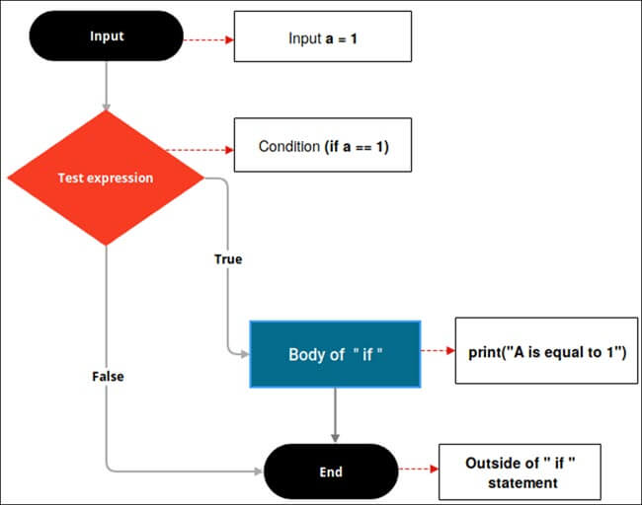

Slide 5
if-else statements
The statement itself says if a given condition is true then execute the statements present inside the “if block” and if the condition is false then execute the “else” block.
The “else” block will execute only when the condition becomes false. It is the block where you will perform some actions when the condition is not true.
if-else statement evaluates the Boolean expression. If the condition is TRUE then, the code present in the “ if “ block will be executed otherwise the code of the “else“ block will be executed
Syntax:
If (EXPRESSION == TRUE):
Statement (Body of the block)
else:
Statement (Body of the block)
Here, the condition will be evaluated to a Boolean expression (true or false). If the condition is true then the statements or program present inside the “if” block will be executed and if the condition is false then the statements or program present inside the “else” block will be executed.

Slide 6
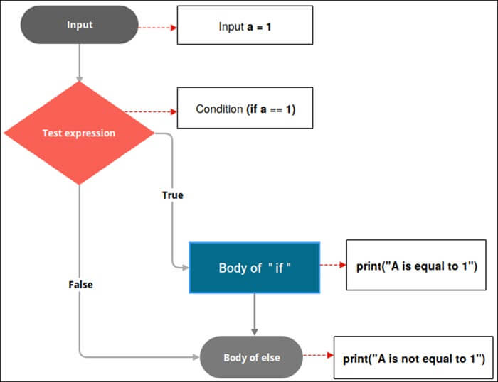

Slide 7
if-else Statements
if Statement
a = 5
if a > 10:
print("The current value inside a is greater than 10.")
else:
print("The current value of a is less than or equal to 10.")
Output
The current value of a is less than or equal to 10.
a = 5
if a == 5:
print("a is equal to 5.")
else:
print("a is NOT equal to 5.")
a = 11
if a > 10:
print("The current value inside a is greater than 10.")
Output
The current value inside a is greater than 10.

Slide 8
elif statements
In Python, we have one more conditional statement called “elif” statements. “elif” statement is used to check multiple conditions only if the given condition is false. It’s similar to an “if-else” statement and the only difference is that in “else” we will not check the condition but in “elif” we will check the condition.
“elif” statements are similar to “if-else” statements but “elif” statements evaluate multiple conditions.
Syntax:
if (condition):
Set of statement to execute if condition is true
elif (condition):
Set of statements to be executed when if condition is false and elif condition is true
else:
Set of statement to be executed when both if and elif conditions are false

Slide 9
Nested if-else statements
Nested “if-else” statements mean that an “if” statement or “if-else” statement is present inside another if or if-else block.
Python provides this feature as well, this in turn will help us to check multiple conditions in a given program.
An “if” statement is present inside another “if” statement which is present inside another “if” statements and so on.
Nested if Syntax:
if(condition):
#Statements to execute if condition is true
if(condition):
#Statements to execute if condition is true
#end of nested if
#end of if

Slide 10
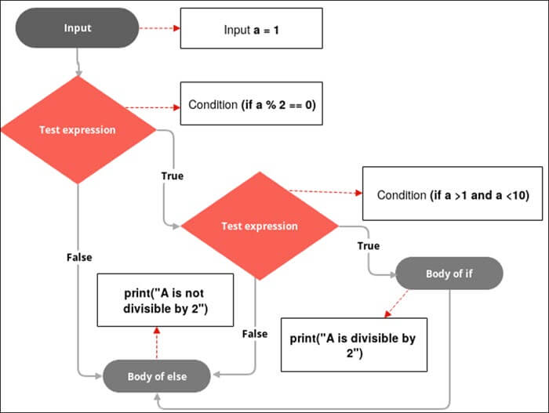

Slide 11
elif statements
Nested if-else statements
num = 9
if (num == 0):
print("Number is Zero")
elif (num > 5):
print("Number is greater than 5")
else:
print("Number is smaller than 5")
num = 5
if(num >0):
print("number is positive")
if(num<10):
print("number is less than 10")

Slide 12
elif Ladder
We have seen about the “elif” statements but what is this elif ladder? As the name itself suggests a program that contains a ladder of “elif” statements or “elif” statements are structured in the form of a ladder.
This statement is used to test multiple expressions.
Syntax:
if (condition):
#Set of statement to execute if condition is true
elif (condition):
#Set of statements to be executed when if condition is false and elif condition is true
elif (condition):
#Set of statements to be executed when both if and first elif condition is false and second elif condition is true
elif (condition):
#Set of statements to be executed when if, first elif and second elif conditions are false and third elif statement is true
else:
#Set of statement to be executed when all if and elif conditions are false

Slide 13
Using elif ladder
my_marks = 90
if (my_marks < 35):
print("Sorry!, You failed the exam")
elif(my_marks > 60 and my_marks > 100):
print("Passed in First class")
else:
print("Passed in First class with distinction")

Slide 14
Using elif with an if-else Statement
Using if-else Chain
user_input = input("Enter a valid number only:")
# Skipping the validation of the user's input
a = float(user_input)
if a > 10:
print("The number is greater than 10.")
elif a == 10:
print("The number is equal to 10.")
else:
print("The number is less than 10.")
user_input = input("Enter a valid number only:")
# For simplicity, skipping the validation of user's input
a = float(user_input)
if a > 10:
print("The number is greater than 10.")
else:
if a == 10:
print("The number is equal to 10.")
else:
print("The number is less than 10.")

Slide 15
Iteration using Loops
In programming, iteration is used for repetition. When you write a program or implement an algorithm, you may need to iterate over a certain part of the code until a specific condition meets. Loop statements help you iterate overt hose portions of the code.
print("Printing 1 to 3:")
print(1)
print(2)
print(3)
When you execute this code, you see the following output:
Printing 1 to 3:
123

Slide 16
The while Loop
The while loop continues executing as long as a certain condition is true. It has the following form:
while “Your specified condition(s)”:
statement-1
statement-2
statement-3
….
It starts with a reserved keyword while. There is a colon (:) after the condition(s) you mentioned. There can be many statements inside the while loop. You indent these lines. You check the condition before you enter this block of statements. If the condition is true, the control can enter the block and execute these statements. You repeat this block of statements till the condition is true.
In short, to come out from a while loop, the condition needs to be false. Otherwise, the block of statements inside the loop will continue executing.
When the condition becomes false, the block of statements inside while loop will no longer execute.Then we say that the control has exited from the while loop. It also means that if the condition is false at the beginning, you cannot enter the body of a while loop at all.
If you enter a loop but do not satisfy the exit criteria, you fall into the trap of an infinite loop.

Slide 17
While loop..
# Printing 1 to 10 using while loop
print("Printing 1 to 10 using while loop:")
current_value = 1
while current_value <= 10:
print(current_value)
# incrementing the value
# Following line is a shortcut for :
# current_value=Current_value+1
current_value += 1
# This statement is placed outside the while loop
print("Job has been done. Exit from the while loop.")

Slide 18
Infinite loop
#Here is the complete program.
# An incorrect implementation of while loop.
# It creates an infinite loop.
i = 0
while i != 1:
print(f"I cannot come out from the loop.i={i}.")

Slide 19
While loop summary..
Using while loops are common in programming. Notice the construction and usage of the while loop again. You can see that there are three major parts which are as follows:
Initialization- You use it before the control enters the while loop.
Condition- You use this to determine whether the control enters the loop. If you enter the loop, the condition is further checked to determine whether the control will be inside the loop, or it will exit from the loop.
Update-You have to implement the proper logic to update your intended variable (which you use in the condition of the while loop). This helps you to come out from the loop and process the next statement if any.
If the control cannot exit from the loop, you fall into an infinite loop.

Slide 20
The for loop
There is another loop called for loop in Python. In certain situations, this loop provides a convenient way to express the steps of a while loop. This program shows you the use of a for loop.
You often use the for loops when you traverse an iterable element like list, tuple, strings, etc. What is an iterable element? In simple terms, an iterable element is such an element that can be looped over. The generalsyntax to traverse and print the content of an iterable element is as follows:
for element in iterable_element:
print(element)
employee_names = ["Sam", "Bob", "George", "Kate", "Julie"]
print("Printing employee names using a 'for' loop:")
for employee in employee_names:
print(employee)

Slide 21
For loop..
#Here is the complete program.
# Printing 1 to 10 using for loop
print("Printing 1 to 10 using a 'for' loop:")
# I use the range(1,11) function to print
# values 1 to 11-1=10
for current_value in range(1, 11):
print(current_value)
# This statement is placed outside the for loop
print("Job has been done. Exit from the 'for' loop.")

Slide 22
Use of break Statement
To exit from a loop based on a certain condition(s). For example, suppose you have the following program:
#to exit from a loop based on a certain condition(s). For example,
#suppose you have the following program:
current_value = 1
while current_value <= 5:
print(current_value)
current_value += 1
#You get the following output when you execute the program:
12345

Slide 23
Cont.
current_value = 1
while current_value <= 5:
print(current_value)
if (current_value == 3):
print("Exit the loop when currnet_value becomes 3.")
break
# incrementing the value
current_value += 1

Slide 24
Using a break statement inside a while loop
print("***Using a break statement inside a while loop.***" )
current_value = 1
print(f"Initially, current_value={current_value}")
print("Exit the loop when current_value becomes 3.")
while current_value < 5:
# incrementing the value
current_value += 1
print(f"The current value={current_value}")
if current_value == 3:
break
print("I'm still inside the while loop.")
# This statement is placed outside the while loop
print("Job has been done. Exit from the while loop.")

Slide 25
Use of continue Statement
Have seen the use of a break statement. There is another interesting keyword in Python called continue . Using this keyword, you can skip some statements inside a loop in an iteration. You place these statements after the keyword continue .
There is a reason for this. When a specific condition is met, you may not want to exit entirely from a loop. Instead, in this iteration, you may want to skip the remaining statements of the loop and go back to the beginning of the loop. The continue keyword is made for this purpose.

Slide 26
Using a continue statement inside a while loop
#Here is the complete program.
print("*** Using a continue statement inside a while loop.***")
current_value = 1
print(f"Initially, current_value={current_value}")
print("I skip the code when current_value becomes 3.")
while current_value < 5:
# incrementing the value
current_value += 1
print(f"The current value={current_value}")
if current_value == 3:
continue
print("I'm still inside the while loop.")
# This statement is placed outside the while loop
print("Job has been done. Exit from the while loop.")

Slide 27
Nested For Loop
The basic syntax of a nested for loop in Python is:
for [iterating_variable_1] in [sequence_1]: #Outer Loop
for [iterating_variable_2] in [iterating_variable_1/sequence_2]: #Inner Loop
[code to execute]

Slide 28
Nested for loop example
print("*** Nested loop example.***")
colors = ["Red","Green","Yellow"]
fruits = ["Mango","Banana"]
for color in colors:
for fruit in fruits:
print(color,fruit,end=" ")
print()

Slide 29
Nested while loop..
i=1
while i<=5:
j=1
while j<=i:
print(j,end=" ")
j=j+1
print("")
i=i+1

Slide 30
Exercise for Conditions Statement
Create a condition to check certain age of people who come to theatre based on their age the ticket prices varies i.e <4 ticket price is 0, <18 ticket price is 120, above 18 the price is 200 rupees.
Create a syllabus for Data analyst course with “Python” ,”SQL” and “Tableau” and check whether the words are in the list if the words exists print as “Data analyst syllabus” else “Out of syllabus”.

Slide 31
Exercise for iterations
1.Create a dictionary with following as a key value pair with Rice as Briyani, Variety as 'Chicken’ & 'Mutton’ navigate through the dict to print the following output.
Output:
You ordered a Briyani with the following variety:
Chicken
Mutton
2.Create a loop to get input from the user to get the information of cities visited by the user. The loop has to end once the user selects the word “quit”
Output:
Please tell me a city you have visited in Tamilnadu:
(Enter 'quit' when you are finished.) Madurai
I'd love to go to Madurai!
Please tell me a city you have visited in Tamilnadu:
(Enter 'quit' when you are finished.) quit

Slide 32
Combined exercise for Condition and for loop
Create a dict with the keys as Prakash, Dhano, Riyaz, Roshan and values as sql, python, Tableau and python. Create a list to contain the keys values and the keys values should be printed for each iteration and if the keys values are in the created list then the output should be “Hi Dhano, I see your favorite language is Python!”

